Slide 1
Detection Lifecycle – from a hypothesis to remediation in a DevOps style
ISSA Polska – Stowarzyszenie ds. Bezpieczeństwa
Systemów Informacyjnych,
Lech Lachowicz
Dyrektor ds. Profesjonalnego Rozwoju
Warszawa, 28-02-2021r.

Slide 2

Disclaimer
Who am I:
IT Security freak with decent background in dev
Threat Defense lead responsible for detections, hunting, automation and breach simulation
Big fan of opensource and automation
Who I’m not:
NOT a full time Developer
NOT A DEVOPS
NOT Alfa and Omega, you can actually do it differently
What is it going to be about:
Better SECURITY
What is it not going to be about:
Software development
Writing code
I won't give you the ultimate recipe… just hints and ideas

Slide 3
Agenda
The basics
Detection Lifecycle
Automating stuff
Transforming
Testing
Deploying

Slide 4
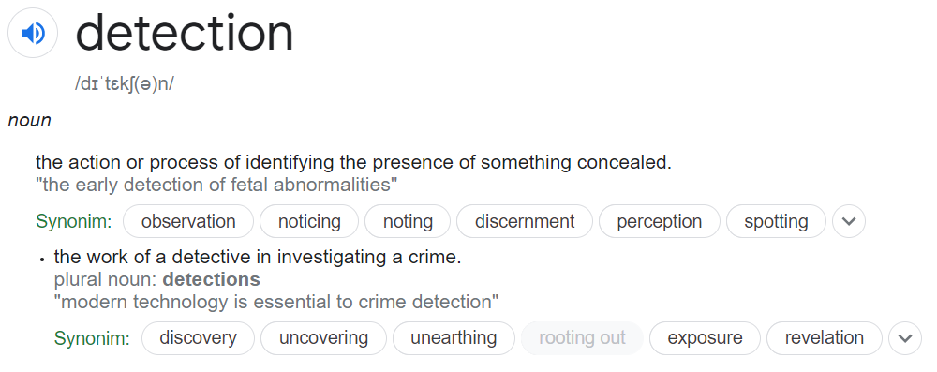
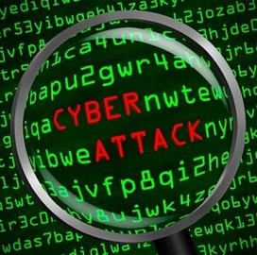
The basics
In Cyber it’s usually a search executed in an analytical platform (SIEM typically) or a more complex set of rules and searches that work together to discover adversary and trigger Incident.

Slide 5

Questions without answers
What are we looking for?
How well are we doing?
How should we prioritize?

Slide 6
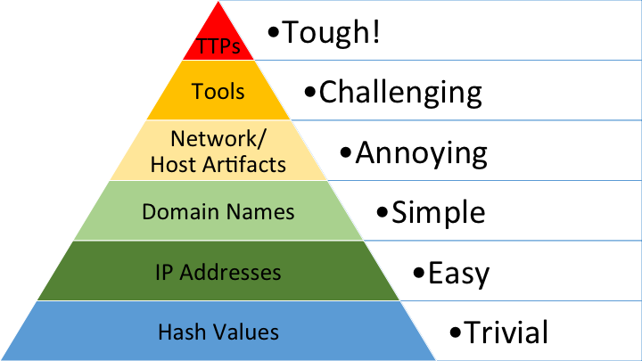

The pyramid of pain
Source: https://detect-respond.blogspot.com//the-pyramid-of-pain.html
Notes:
Hash Values: SHA1, MD5 or other similar hashes that correspond to specific suspicious or malicious files. Often used to provide unique references to specific samples of malware or to files involved in an intrusion.
IP Addresses: It's, um, an IP address. Or maybe a netblock.
Domain Names: This could be either a domain name itself (e.g., "evil.net") or maybe even a sub- or sub-sub-domain (e.g., "this.is.sooooo.evil.net")
Network Artifacts: Observables caused by adversary activities on your network. Technically speaking, every byte that flows over your network as a result of the adversary's interaction could be an artifact, but in practice this really means those pieces of the activity that might tend to distinguish malicious activity from that of legitimate users. Typical examples might be URI patterns, C2 information embedded in network protocols, distinctive HTTP User-Agent or SMTP Mailer values, etc.
Host Artifacts: Observables caused by adversary activities on one or more of your hosts. Again, we focus on things that would tend to distinguish malicious activities from legitimate ones. They could be registry keys or values known to be created by specific pieces of malware, files or directories dropped in certain places or using certain names, names or descriptions or malicious services or almost anything else that's distinctive.
Tools: Software used by the adversary to accomplish their mission. Mostly this will be things they bring with them, rather than software or commands that may already be installed on the computer. This would include utilities designed to create malicious documents for spearphishing, backdoors used to establish C2 or password crackers or other host-based utilities they may want to use post-compromise.
Tactics, Techniques and Procedures (TTPs): How the adversary goes about accomplishing their mission, from reconnaissance all the way through data exfiltration and at every step in between. "Spearphishing" is a common TTP for establishing a presence in the network. "Spearphishing with a trojaned PDF file" or "... with a link to a malicious .SCR file disguised as a ZIP" would be more specific versions. "Dumping cached authentication credentials and reusing them in Pass-the-Hash attacks" would be a TTP. Notice we're not talking about specific tools here, as there are any number of ways of weaponizing a PDF or implementing Pass-the-Hash.

Slide 7
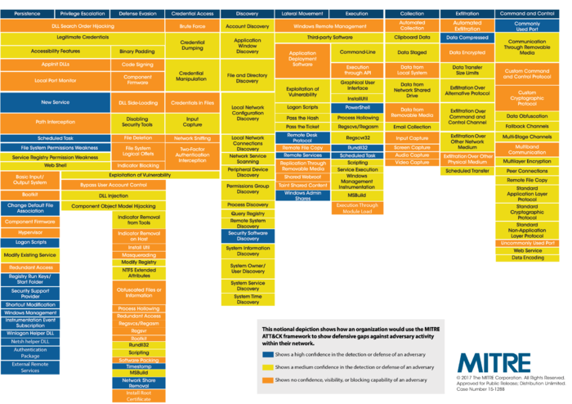
Mitre Att&ck Framework
The ATT&CK matrix provides a framework for identifying tactics and techniques used by threat actors

Slide 8
The detection lifecycle
CTI/OSINT
Detection opportunity
Develop detection
Test detection

Slide 9
The detection lifecycle
CTI/OSINT
Detection opportunity
Develop detection
Test detection

Slide 10
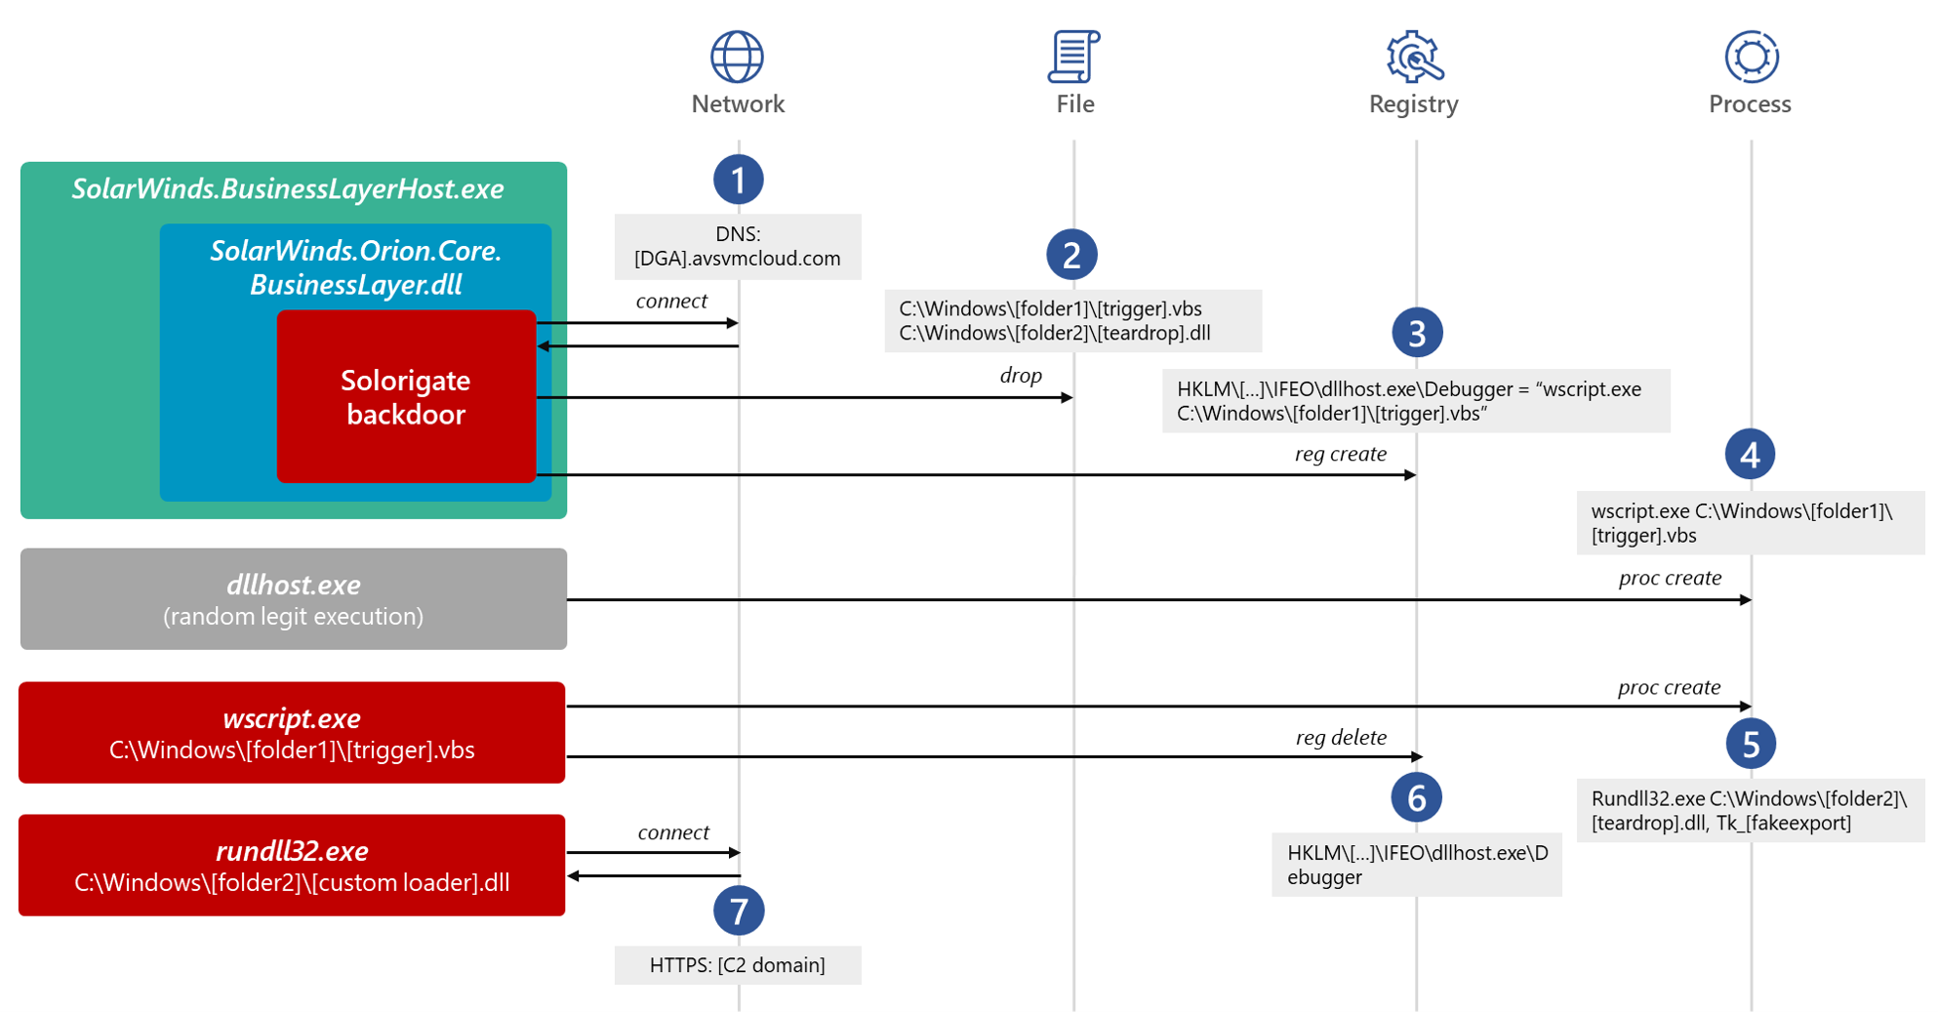
Lets start with OSINT
Recently hot topic – Solorigate: From SUNBURST to TEARDROP and Raindrop
Source: https://www.microsoft.com/security/blog/2021/01/20/deep-dive-into-the-solorigate-second-stage-activation-from-sunburst-to-teardrop-and-raindrop/
1
Not worth bothering
T1546.012
Better but will be FP prone if used without process name
2
3
Now that’s something – wscript as debugger… no thanks!
We’ll get wscript run every time dllhost.exe is spawned. This will cut the process ancestry here!
4
Notes:
https://blog.malwarebytes.com/101/2015/12/an-introduction-to-image-file-execution-options/

Slide 11
The detection lifecycle
CTI/OSINT
Detection opportunity
Develop detection
Test detection

Slide 12
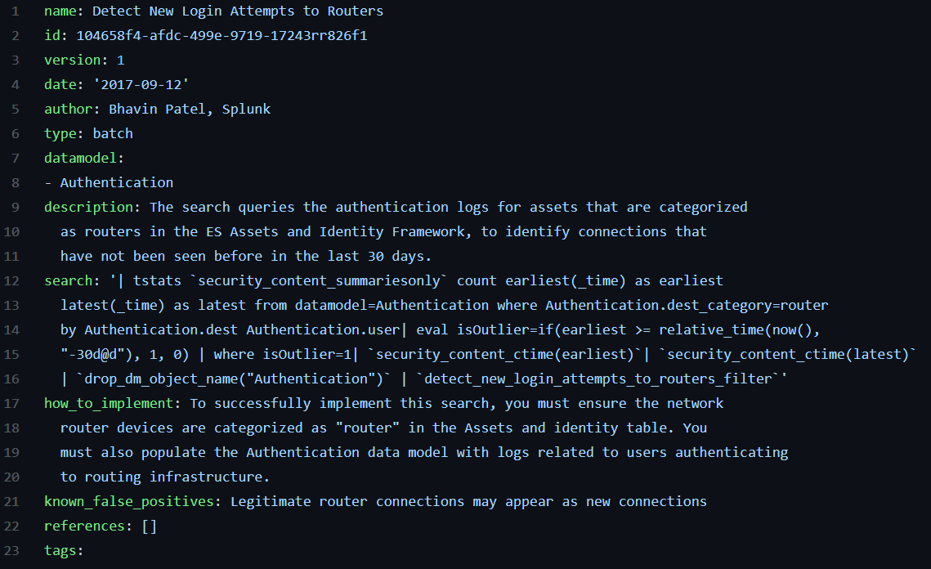
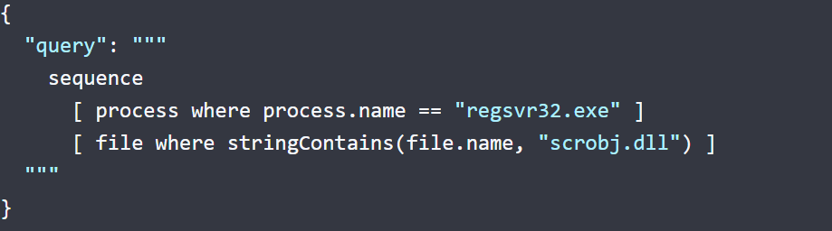
Option 1 – use the SIEM language
Splunk Security Content
Open sourced and yaml based
Contains a lot more than just the search
Splunk optimized, fits EnterpriseSecurity and Core perfectly
Well documented with a lot of content and app ecosystem to support analyst
IMHO – still work in progress….
Elastic EQL
Open sourced and yaml based, but… requires Enterprise
Good documentation
Elastic optimized, wont work with anything else
Not too many examples and out of box detections
Uses ECS – Elastic Common Schema
https://github.com/splunk/security_content
https://www.elastic.co/guide/en/ecs/1.9/index.html

Slide 13
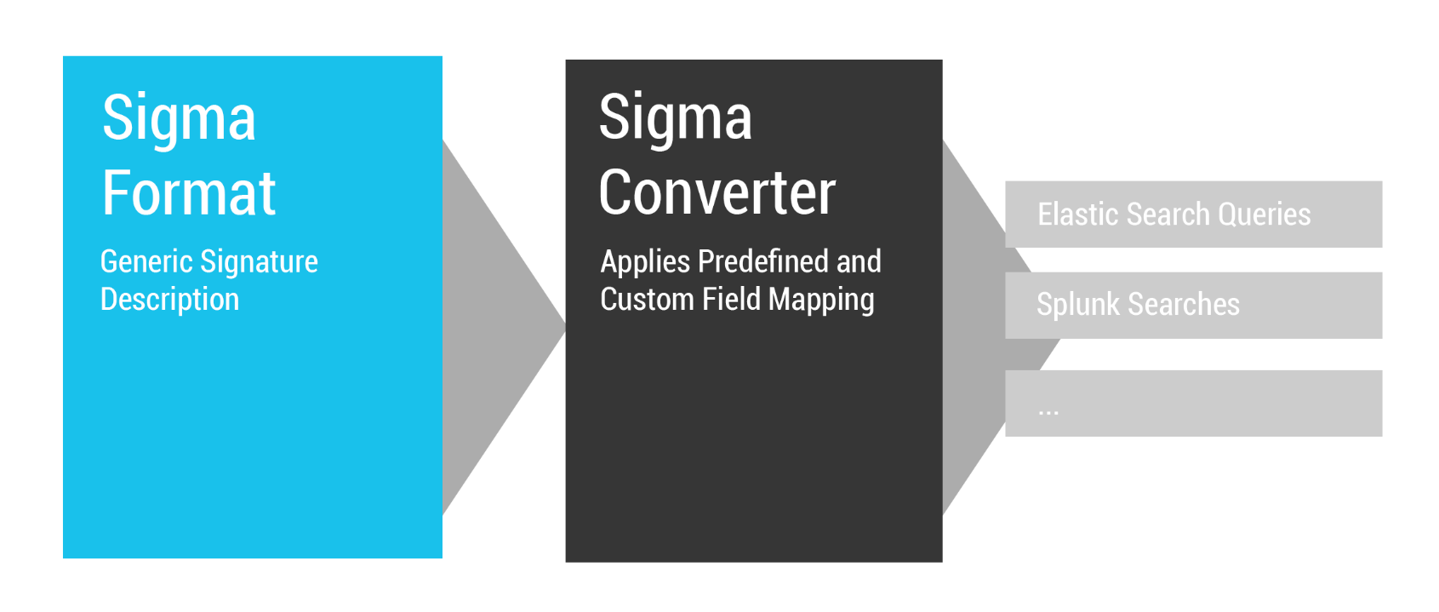
Option 2 – use SIGMA
Quote: “Sigma is for log files what Snort is for network traffic and YARA is for files.”
Yaml based and open sourced
Great documentation
Extensible
Flexible
Soooo many examples!
Good enough but not perfect…
Good for detections
but not right for lifecycle tracking
Source: https://github.com/Neo23x0/sigma

Slide 14
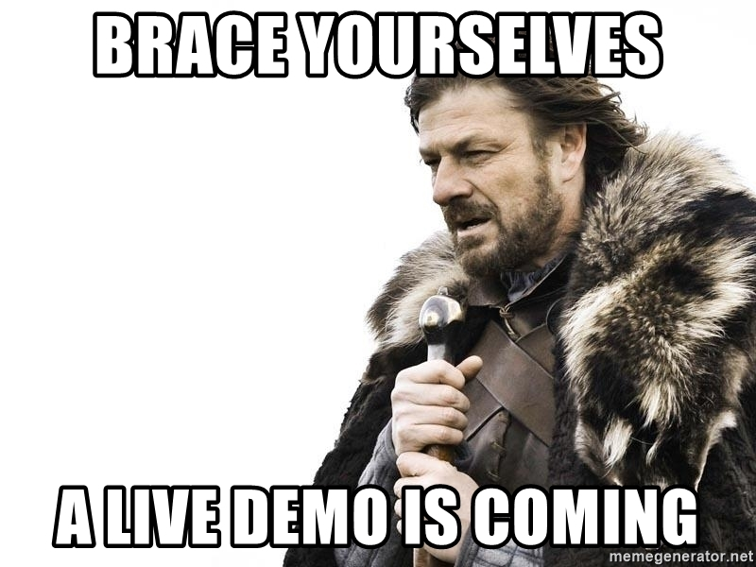
How to use SIGMA

Slide 15
The detection lifecycle
CTI/OSINT
Detection opportunity
Develop detection
Test detection

Slide 16
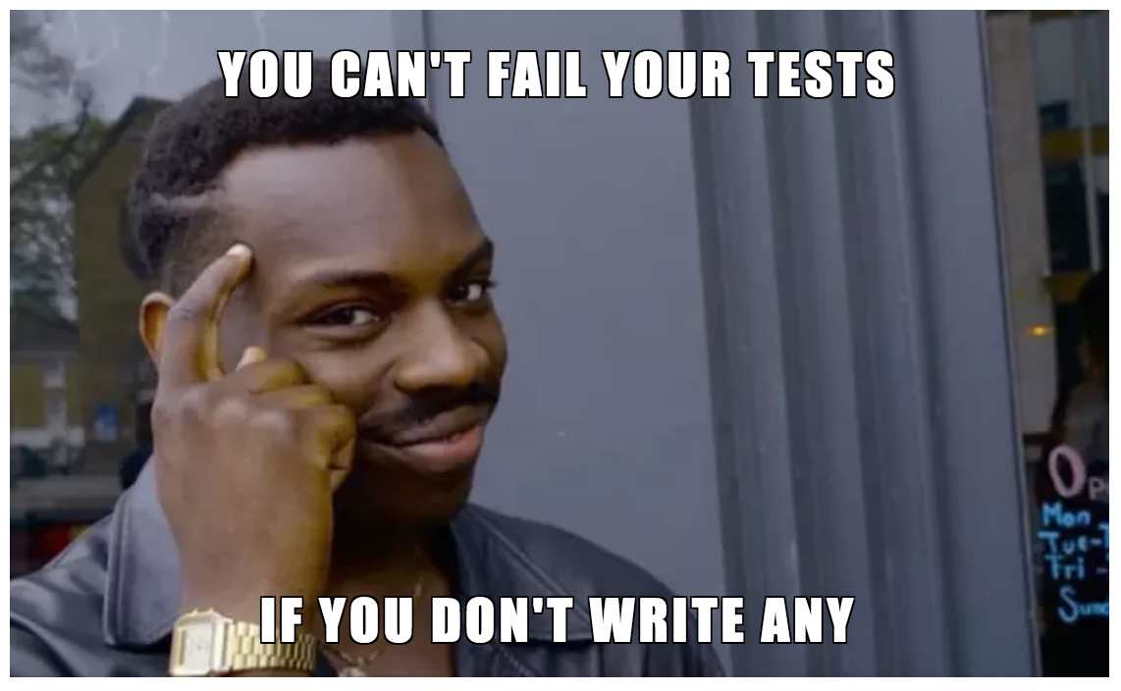
What for?

Slide 17
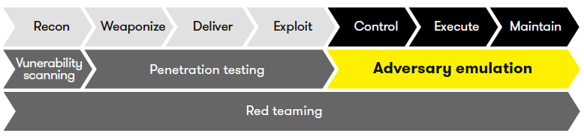
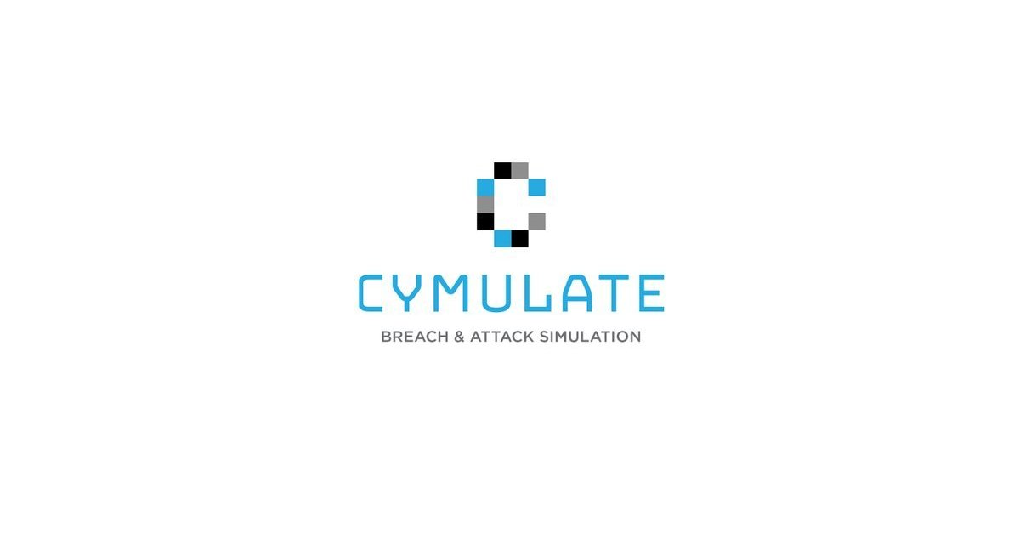




Breach/Attack/adversary Simulation platforms

Slide 18
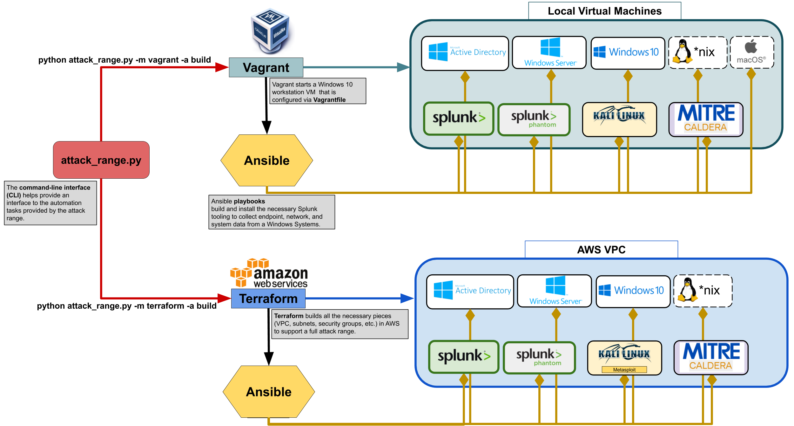
Building test environment - Splunk
https://github.com/splunk/attack_range

Slide 19
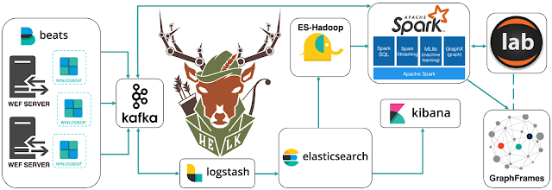
Building test environment - HELK
https://github.com/Cyb3rWard0g/HELK
No attack simulation platform ready out of box. Will have to add it ☺.

Slide 20
Atomic Red Team
Atomic Red Team allows every security team to test their controls by executing simple "atomic tests" that exercise the same techniques used by adversaries (all mapped to Mitre's ATT&CK).
https://github.com/redcanaryco/atomic-red-team

Slide 21
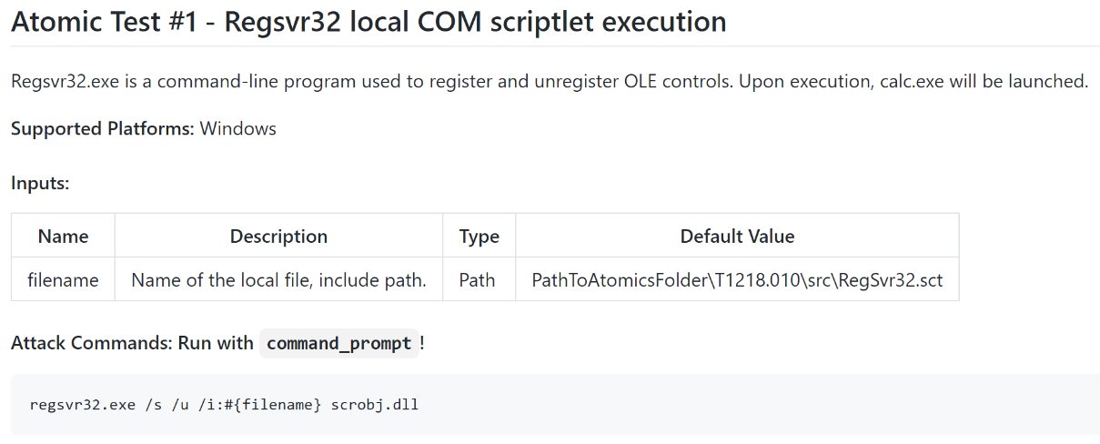

Atomic Red Team
Atomics – test description
Execution Framework

Slide 22
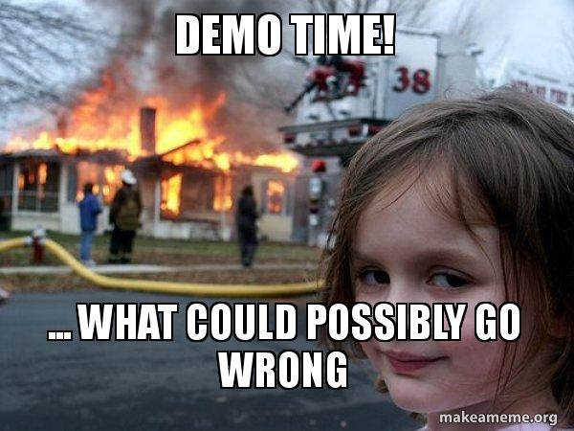
Atomic Red Team - demo

Slide 23
The detection lifecycle
CTI/OSINT
Detection opportunity
Develop detection
Test detection

Slide 24
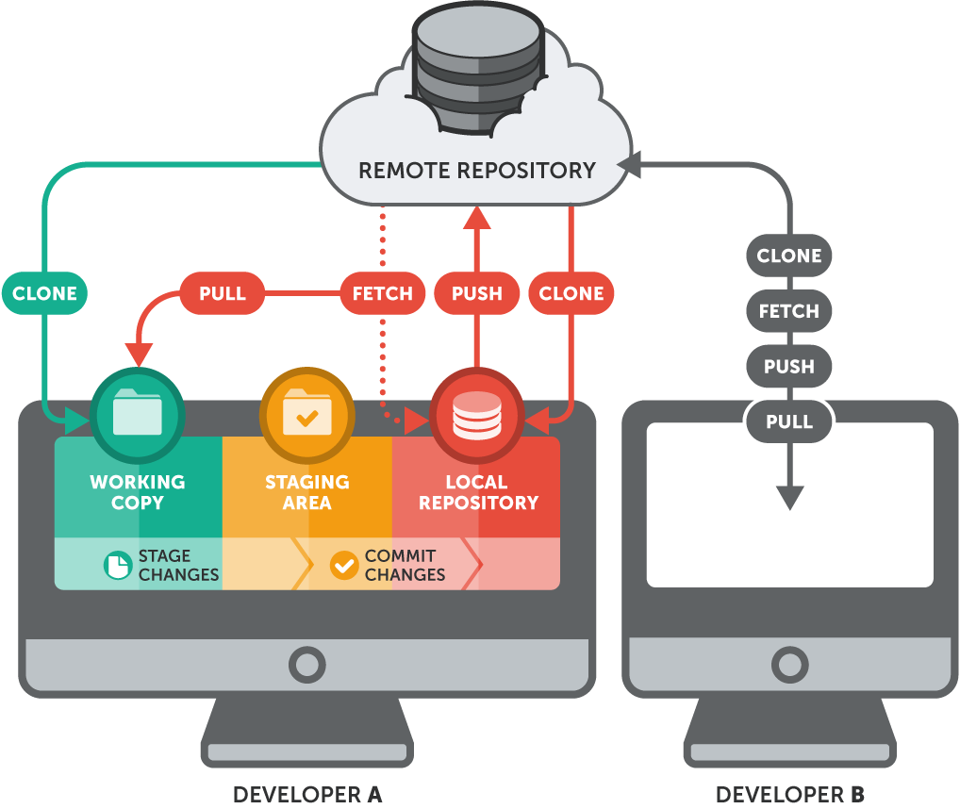
GIT as Detection Catalog

Slide 25

So, what's so hard about it?
We set it up and forget
Some are complex to create and test
It’s a “fingers crossed” approach – we hope it works
Many tweaks by multiple analysts
Changing datasets
Changing technologies
We need to track the effectiveness

Slide 26
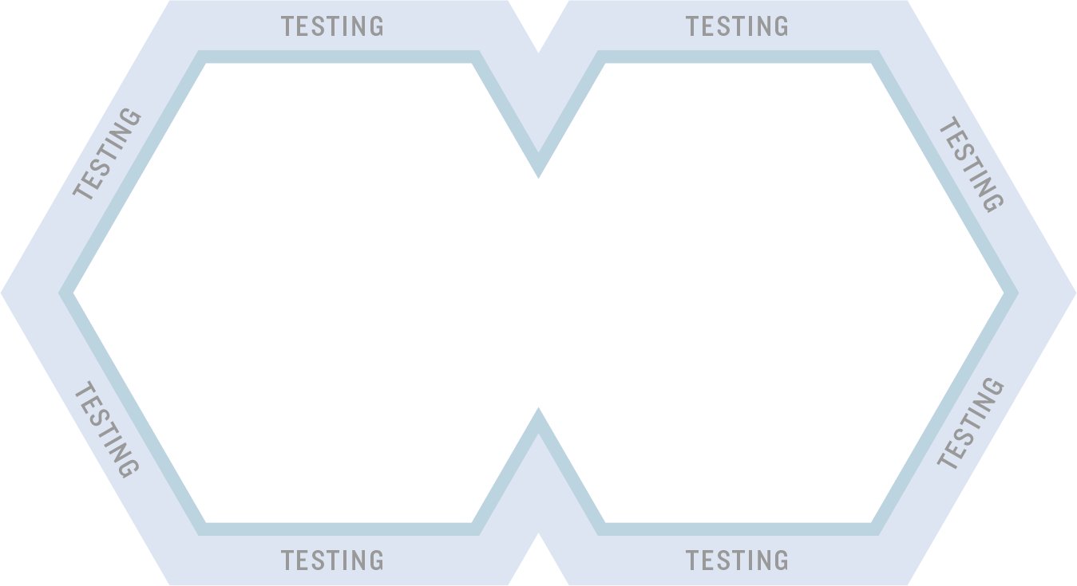
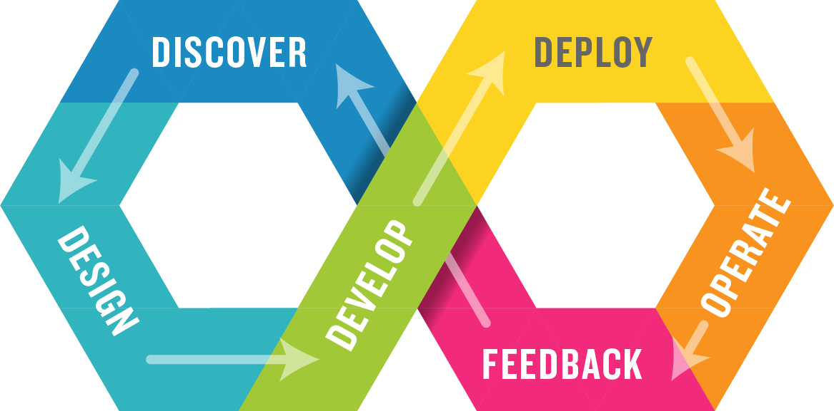
That’s where DevOps kicks in
Provides interoperability of software and operations to ensure the maximal data access, knowledge dissemination, and automation
Bridges the siloed operations and development teams
Leverages semi autonomous technologies to facilitate data driven development and communication
Complex tasks are handed off to the machine automation to mitigate the burden of distraction and context switching
Addresses the challenge of managing and maintaining the software development process and tools

Slide 27
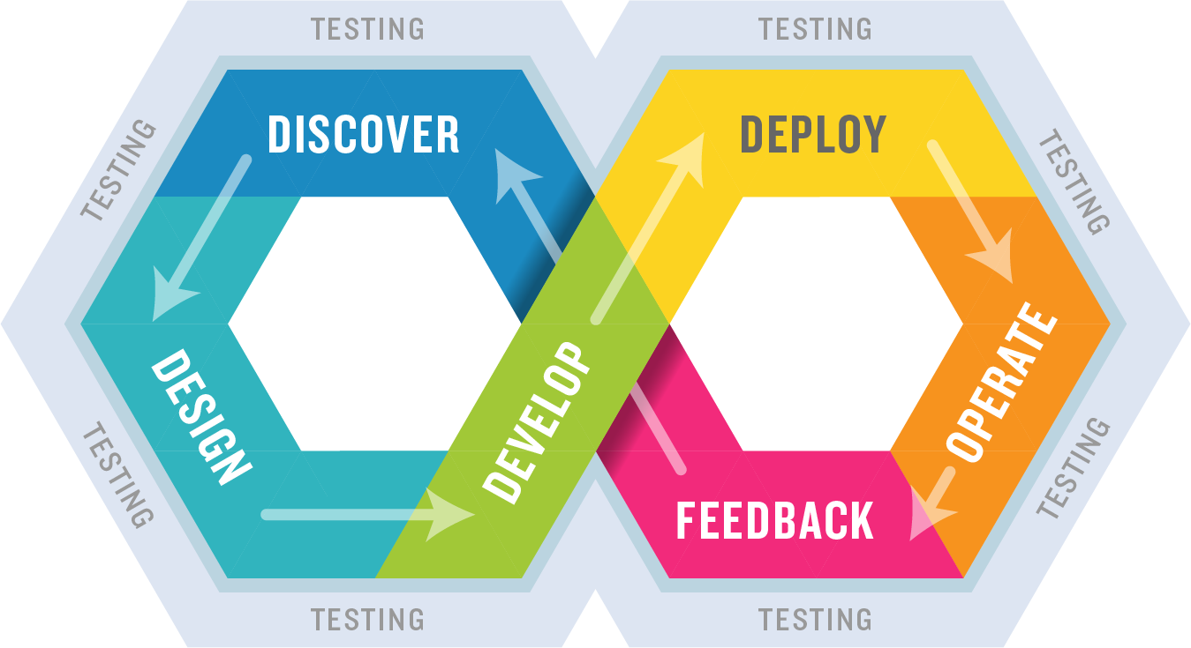
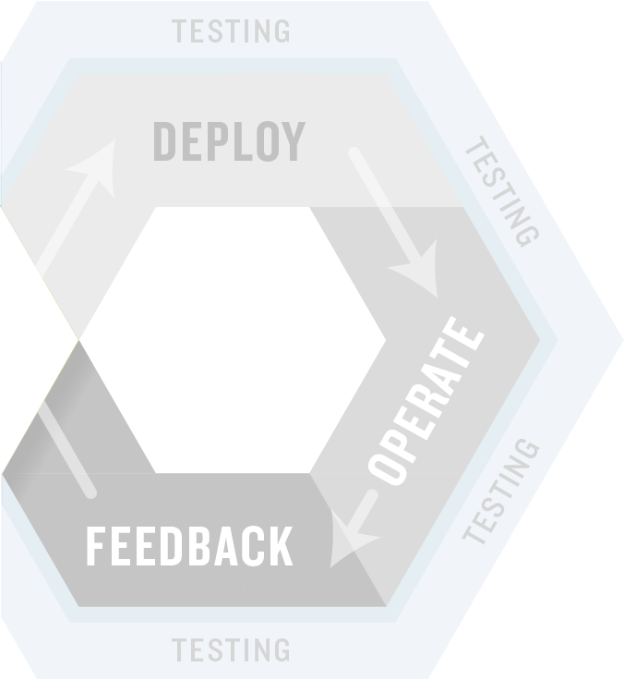
Shifting Left – Testing Earlier in the Process
Integrate automated unit, functional, API, performance, and security testing into your CI process.
Exploratory testing before the code is finished.

Slide 28
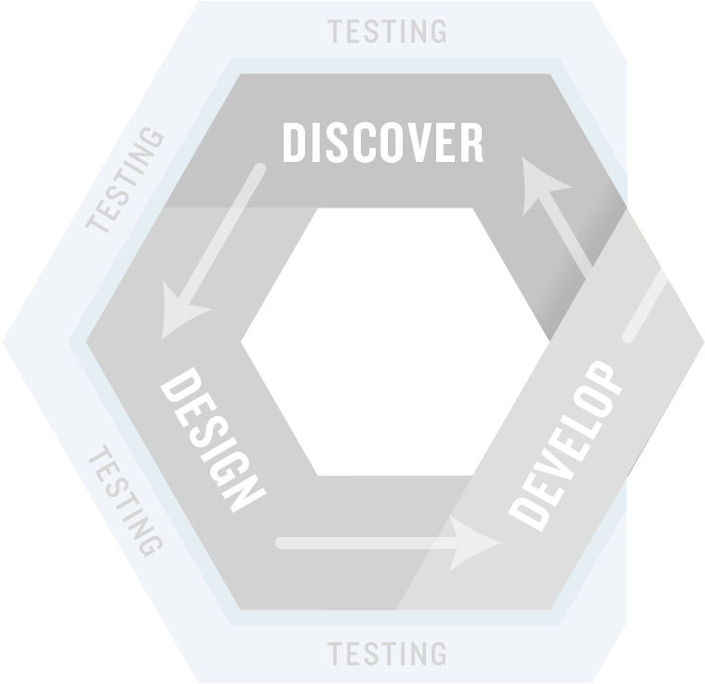
Shifting Right – Testing in Production
Integrate monitoring of the live application into your testing process.
Include system monitoring and metrics as well as input from customer support and the business.

Slide 29
CI/CD – automatically test and deploy
Integrate monitoring of the live application into your testing process.
Include system monitoring and metrics as well as input from customer support and the business.

Slide 30
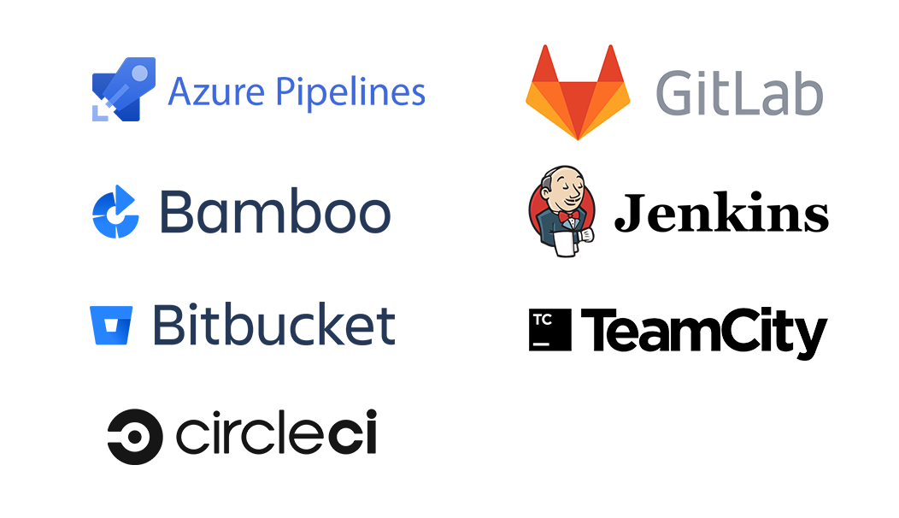
CI/CD tools

Slide 31






Detection CI/CD pipeline
PrePush hooks To validate
Lead
CI/CD pipeline
Runs deployment
Accept
Push
Pull Request
Pull Request
Deploy
Analyst
Visual tools
GIT
Feature-Detection branch
GIT
Staging branch
GIT
Production branch
Unit testing targeting only the changes in the branch. This may include:
Checking if search is functional
Checking if search returns values
Checking if search contains all predefined fields and correct values etc.
Integration tests run for all affected objects. For example, if a related object was changed then all the related detections should be retested.
If simulation was defined, rerun the simulations for all related objects.
Automatically create pull request
CI/CD pipeline
Validation
Unit Tests
CI/CD pipeline
Integration
Tests

Slide 32


Questions

Slide 33
Thank you
Lech Lachowicz
Mail to: lech.Lachowicz@issa.com.pl

